Slide 1
Systems Analysis and Design CT026-3-1
Types of Testing

Slide 2
Topic & Structure of The Lesson
Testing
Importance
Types of testing
Test Plan

Slide 3
Learning Outcomes
By the end of this lecture, YOU should be able to :
Discuss the importance of testing
Identify the types of testing
Prepare a test plan

Slide 4
Key Terms you must be able to use
If you have mastered this topic, you should be able to use the following terms correctly in your assignments and exams:
Unit testing
Integration testing
System testing

Slide 5
Software Testing
Testing is the process of exercising a program with the specific intent of finding errors prior to delivery to the end user.

Slide 6
Software Testing
Each program must tested to make sure it functions correctly
Desk checking : the process of reviewing the program code to spot logic errors, which produce incorrect result
Groups of three to five IT staff members participate in code review
Objective is to have a peer group identify errors, apply quality standards, and verify that the program meets the requirements of the system design specification

Slide 7
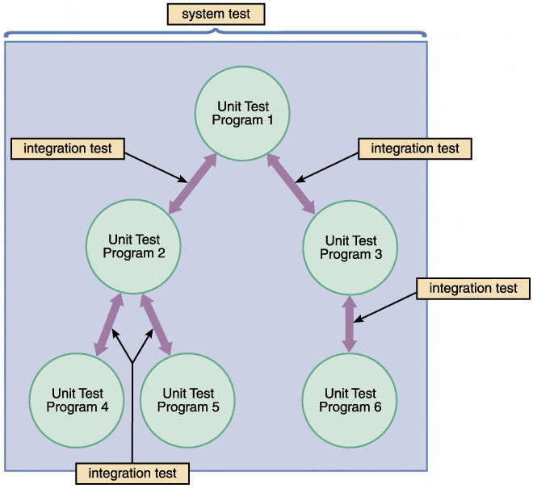
Types of testing
FIGURE 11-22 The first step in testing is unit testing, followed by integration testing, and then system testing

Slide 8
Types of testing
Unit Testing
The testing of an individual program or module
Objective is to identify and eliminate execution errors that could cause the program to terminate abnormally, and logic errors that could have been missed during desk checking
Test data should contain both correct data and erroneous data and should test all possible situations that could occur

Slide 9
Types of testing
Programs that interact with other programs and files are tested individually, before they are integrated into the system
Someone other than the programmer who wrote the program usually creates the test data and reviews the results

Slide 10
Types of testing
Integration Testing
Testing two or more programs that depend on each other to make sure that the programs work together properly

Slide 11
Types of testing
System Testing
Verify that all system components are integrated properly and that actual processing situations will be handled correctly
Confirm that the information system can handle predicted volumes of data in a timely and efficient manner

Slide 12
Types of testing
Verify that all system components are integrated properly and that actual processing situations will be handled correctly
Confirm that the information system can handle predicted volumes of data in a timely and efficient manner

Slide 13
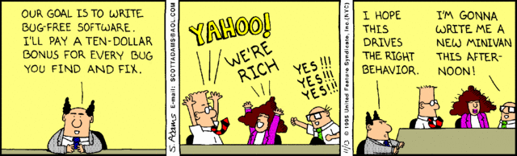
Test Plan
Used as a guide to test software.
Uses ‘dummy data’ (sample data)
Usually prepared before software is built
Prepared by ‘software testers’

Slide 14
Test Plan - Example
TEST DATE / TIME: |  |  | PROJECT ID:
TEST BY: |  |  | SYSTEM TITLE:
TEST CASE | TEST TYPE | TEST STEPS | EXPECTED RESULT | ACTUAL RESULT | REMARKS
1. User Sign-in | Unit Test | Open application Enter User Name as “X” and ……. | User successfully signed-in into the system, welcome page displayed. | Error – does not show error when ‘space’ is used in ID | Correction made to code to check ID validity.
2. Update User Profile

Slide 15
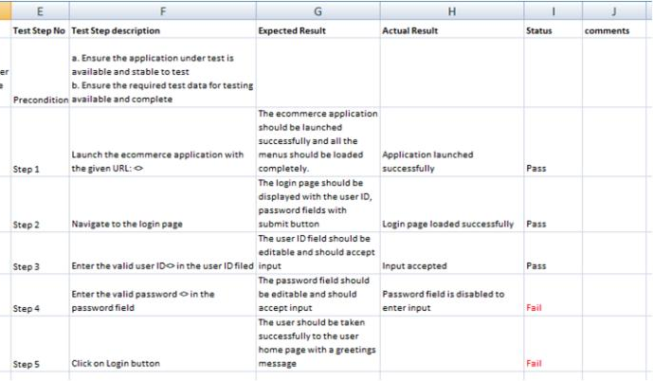

Slide 16
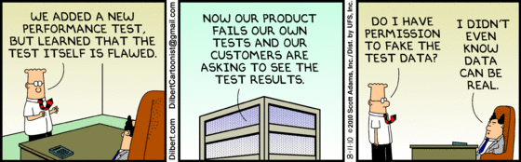
In September 2015, the Environmental Protection Agency (EPA) found that many VW cars being sold in America had a "defeat device" - or software - in diesel engines that could detect when they were being tested, changing the performance accordingly to improve results. The German car giant has since admitted cheating emissions tests in the US. (http://www.bbc.com/news/business-34324772 )
VW will recall 8.5 million cars in Europe, including 2.4 million in Germany and 1.2 million in the UK, and 500,000 in the US as a result of the emissions scandal.

Slide 17
Quick Review Question
Why testing is important ?
What are the main types of testing?

Slide 18
Summary of Main Teaching Points
Testing
Importance
Types of testing

Slide 19
Question and Answer Session
Q & A

Slide 20
What we will cover next
Maintenance
Maintenance tasks
Maintenance Management

